Slide 1
UI Tweening in Unity
Creating Animations for Your Games UI
By Yssie Vargas
Notes:
Hello everyone! Today, I’m going to walk you through UI tweening in Unity. We’ll be focusing on creating smooth UI animations using AnimationCurves, rather than relying on external libraries like LeanTween. By the end of this, you’ll have a solid understanding of how to animate UI elements effectively.

Slide 2
What is UI Tweening?
UI Tweening refers to the short, smooth, animated transitions between UI states.
Instead of instantly changing a UI element’s color, position, size, or transparency, we can use tweening to gradually animate the changes over time.
This improves the Game Feel by allowing the interface to be more dynamic.
Examples of UI tweening in games
https://www.youtube.com/watch?v=9N8oeegbeFM&list=PL1hX1qD7bI72dSwYD1aR8I63zMuuPfLvq
https://www.gameuidatabase.com/uploads/video/Aviary-Attorney11242024-063054-6487.mp4
Notes:
What is UI Tweening?
It refers to smooth, animated transitions between UI states.
Instead of instantly changing UI elements (color, position, size, transparency), we animate them over time.
This makes the UI feel more dynamic and polished, since they are usually the more static aspects of the game
Why use tweening?
It enhances user experience and game feel.
Makes UI interactions more engaging and visually appealing.
Here are some exmaples of cool uses of UI tween that adds to the Game feel. In candy crush, the UI has a cool, bounce/puppet like animation that add to the playful, childlike lightheartedness, the game tries to envoke in its players

Slide 3
What can you do with UI Tweening?
Common Use Cases:
Fading elements (buttons, panels, popups)
Sliding UI components (menus, scoreboards, notifications)
Scaling effects (buttons pulsing, UI shrinking and expanding)
Complex motion (smooth custom animations using keyframes)
Notes:
Tweening can be used for:Fading elements (making buttons appear/disappear smoothly).
Sliding UI components (e.g., menus or notifications).
Scaling effects (making a button pulse when clicked).
Complex motion (custom animations with keyframes).
This tutorial will focus on these core types of tweening.

Slide 4
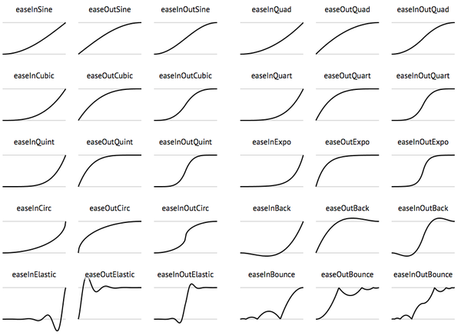
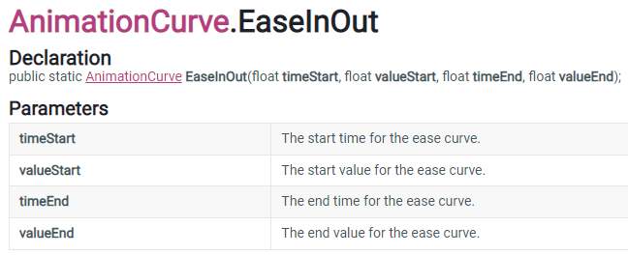
Animation Curve Easing
Note that a lot of tweening can be done with just Unity, without referring to any Library Packages.
What is easing?
Easing controls the speed of the animation, like starting slow and speeding up, to mimic the dynamic movement of reality.
When a car stops and goes, it will slow down gradually and then pick up speed again after stopping.
Instead of moving linearly, easing makes motion feel more natural.
AnimationCurve is a Unity default type that can be used for tweening.
See examples of these curves,
how they effect motion,
and grab the math:
https://easings.net/
AnimationCurve.EaseInOut(0f, 0f, 1f, 1f);
Notes:
What is easing? Easing controls the speed of an animation over time.
Why does it matter? It makes animations feel natural, mimicking physics (e.g., acceleration and deceleration).
Instead of moving at a constant speed, easing lets us ramp up and slow down for a smooth effect.
Unity’s AnimationCurve lets us define these custom transitions.
Code Snippet Example Explanation:
We use AnimationCurve.EaseInOut(0f, 0f, 1f, 1f); to create a natural start/stop motion.
This is used in the fade-in effect for the start button.

Slide 5
Animation Curve Easing
Notes:
This video demonstrates why easing can be so important in changing the feeling of the game. By having dynamic UI, the game becomes more engaging and can provide valuable player feedback.

Slide 6
Custom Key Frame Easing
Why Use Keyframe-Based Motion?
Instead of predefined easing curves, we can manually define motion behavior.
Useful for creating unique, non-standard animations that feel more organic.
Lets us control speed, acceleration, and overshoot with precision.
private AnimationCurve slideEase = new AnimationCurve(
new Keyframe(0f, 0f, 0f, 3f), // Starts slow
new Keyframe(0.3f, 0.5f, 2f, 2f), // Gains some speed
new Keyframe(0.6f, 1.3f, 3f, -3f), // Overshoots further for more bounce
new Keyframe(0.8f, 0.9f, -2f, -2f), // Corrects back towards final position
new Keyframe(1f, 1f, -1f, 0f) // Settles in final position
);
Notes:
Code Breakdown:
The first keyframe starts the motion slow.
The second keyframe increases speed and overshoots.
The final keyframe settles into position.

Slide 7
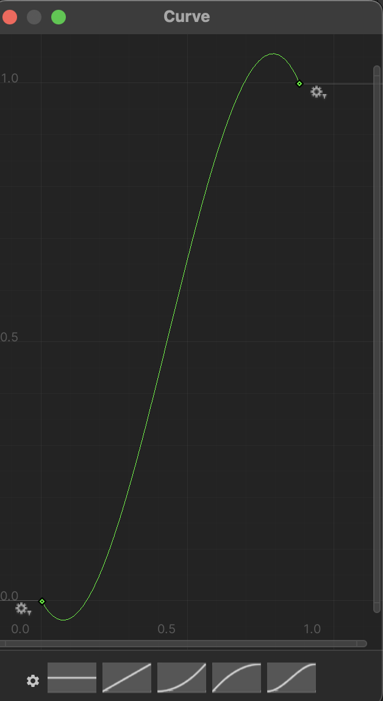
Public Animation Curves
Like other unity objects, you can make a public animation curve that can be modified in the inspector.
Why Use Public Animation Curves?
Instead of hardcoding easing, we expose curves in the Unity Inspector.
This allows designers to tweak motion without modifying code.
public AnimationCurve pulseEase; // Set this in Unity
private float pulseProgress = 0f;
void Update()
{
pulseProgress += Time.deltaTime * 2f;
float scale = pulseEase.Evaluate(pulseProgress); button.transform.localScale = Vector3.one * scale;
}
Notes:
Slide: Public Animation Curves
Instead of hardcoding easing into the script, we can expose it in Unity’s Inspector.
Why is this useful? Designers can tweak the animation without modifying code.
Code Example:
pulseEase.Evaluate(pulseProgress); reads the curve value at different times.
This lets us create a pulsing button effect.
The pulsing effect allows for responsive player feedback and

Slide 8
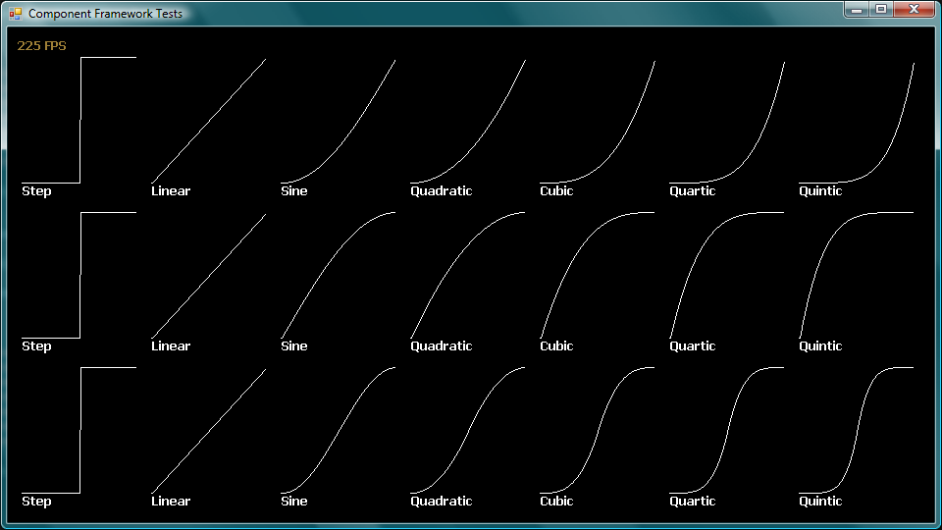
Tweening with Math Functions
Tweening with math functions means using Unity’s built-in math operations (like Lerp, SmoothStep, PingPong, Sin, etc.) to create smooth transitions over time.
Why use Tweening with Math Functions?
Lightweight, flexible, and accessible way to animate without extra tools
Helps you understand how tweening and easing work behind the scenes
shrinkTime += Time.deltaTime / 0.2f;
float phase = Mathf.PingPong(shrinkTime, 1f);
scorePanel.transform.localScale = Vector3.Lerp(Vector3.one, Vector3.one * 0.9f, Mathf.SmoothStep(0, 1, phase));
Notes:
Instead of relying on AnimationCurves or tweening packages, you directly control the animation by applying math to values like position, scale, or color.
shrinkTime += Time.deltaTime / 0.2f;
This increases a timer (shrinkTime) each frame.
Dividing by 0.2f means the whole shrink or expand phase lasts about 0.2 seconds.
In other words, it controls the speed of the animation.
float phase = Mathf.PingPong(shrinkTime, 1f);
PingPong makes the value bounce back and forth between 0 and 1.
That’s what creates the “shrink then expand” effect without needing two separate loops.
scorePanel.transform.localScale = Vector3.Lerp(Vector3.one, Vector3.one * 0.9f, Mathf.SmoothStep(0, 1, phase));
Lerp smoothly blends between the original scale (1) and the shrunk scale (0.9).
SmoothStep eases the transition so it slows down at the start and end instead of looking linear and robotic.
The result: the score panel shrinks down slightly, then grows back to normal size with a natural bounce feel.

Slide 9
Tweening with Libraries (LeanTween)
Instead of manually coding an animation with animation curves or easing, you can use Unity Libraries like LeanTween to simplify the code.
Why Use LeanTween?
Lightweight and efficient animation library for Unity.
It simplifies animations with fewer lines of code compared to manually controlling animation states.
Allows for easy chaining of animations with setOnComplete().
Supports a variety of easing functions (easeInOutQuad, easeOutBounce, etc.).
Non-blocking: doesn't require Update() to manage animations
LeanTween.alphaCanvas(startButton.GetComponent<CanvasGroup>(), 1f, 0.5f).setEase(LeanTweenType.easeInOutQuad);
LeanTween.moveY(startButton, 0, 1f).setEase(LeanTweenType.easeOutBounce);
The first line fades in the button using alphaCanvas(), which modifies the alpha of a CanvasGroup attached to the button.
The second line moves the button’s Y position smoothly over 1 second using easeOutBounce.

Slide 10
Recap!
Why UI Tweening is Important
Makes UI feel more dynamic and responsive.
Improves user experience by grabbing and guiding their attention naturally.
Used in professional applications, games, and interactive media.
Helps maintain a clean and modern interface.
What We’ve Covered So Far
Different types of UI animations: fading, sliding, pulsing, and scaling.
Using Animation Curves for custom movement.
How LeanTween simplifies UI animation.
Best practices for smooth and efficient UI transitions.

Slide 11
Next up: Demo ->
How YOU can implement simple UI Tweening in your game!!

Slide 12
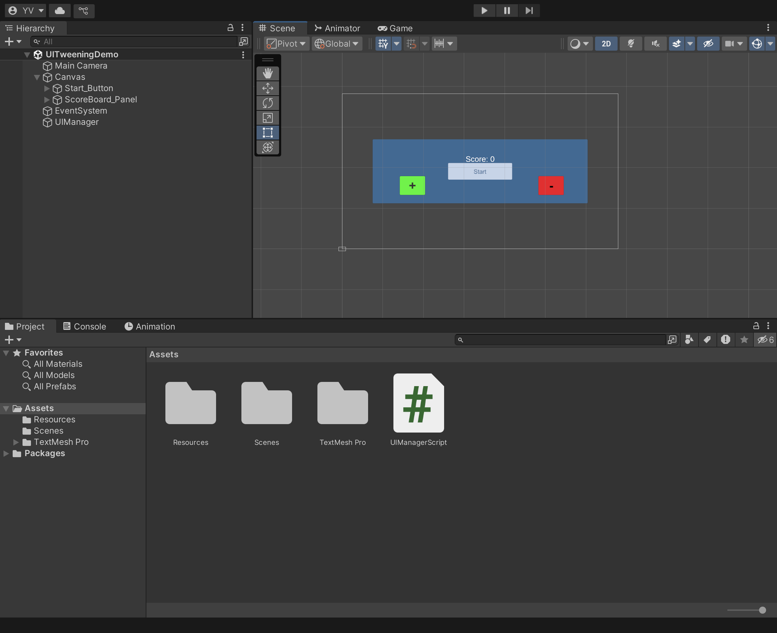
Setting up the project
Open Unity
Open your previous 2D Project
Import my UITweening Package in the Assests folder by right clicking in the Projects Tab and selecting Import Package.
Open the UITweeningDemo Scene. Your screen should look like this ->
Notes:
Steps to create the project:
Open Unity, create a new 2D project and name it UI Tween Demo.
Add a Canvas: Right-click Hierarchy → UI → Canvas.
Set Canvas properties:
Render Mode: Screen Space - Overlay
Canvas Scaler: Scale With Screen Size
Reference Resolution: 1280 x 720
Change the background color if desired.

Slide 13
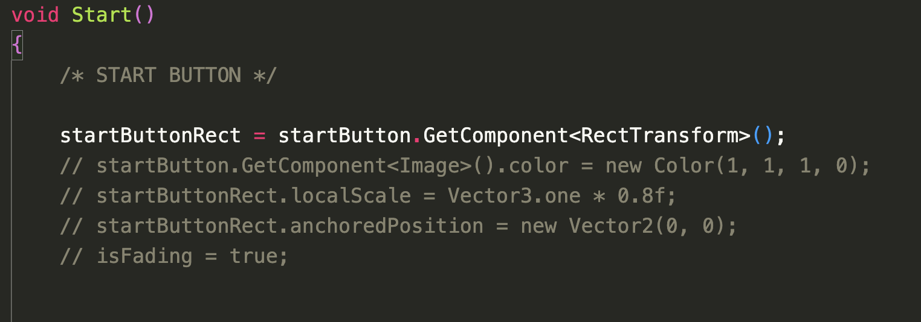
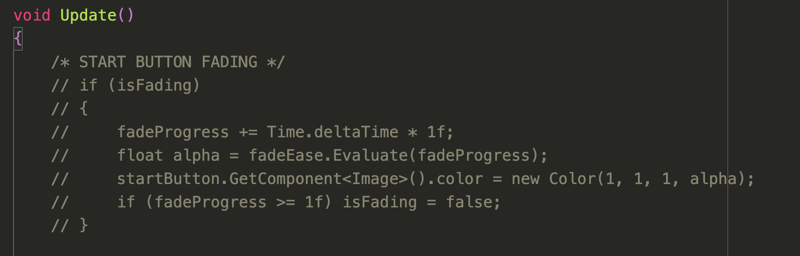
Basic UI Animation (Animation Curve Ease In)
Locate the Start Button in the Hierarchy, Under the Canvas
In the UIManager script, uncomment the code on the left slide to make the Start Button be invisible when the game starts.
Notice the boolean value "isFading = true". This makes it so as the game starts, it will trigger the method that’s starts the fading animation.
Now, when you start the game, you will see the button start invisible and fade in over time.
Notes:
In this section, we’ll animate the fade-in effect for a UI button.
The goal is to make the button start invisible and then gradually become visible when the game begins.
This creates a smooth UI transition instead of a sudden appearance.

Slide 14
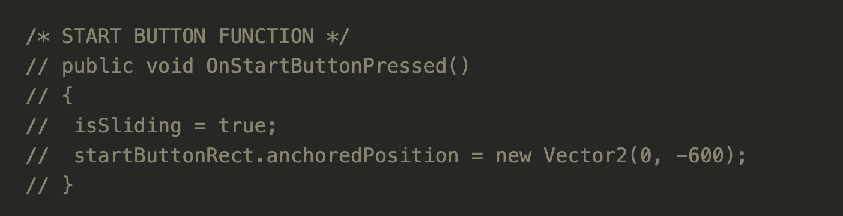
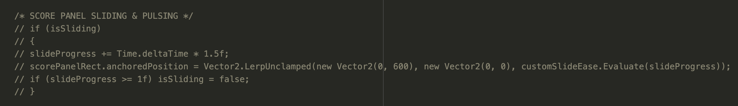
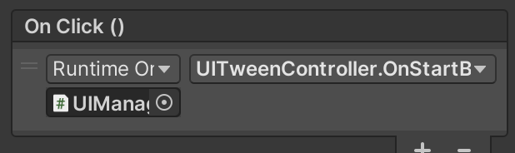
Moving UI Elements (Custom Ease)
In the UI Manager Script, uncomment the public method OnStartButtonPressed() to trigger the start of the animation for the scoreboard UI
Additionally, uncomment the code to the right inside Update(). This loop starts the sliding animation for the scoreboard, using the custom keyframe we have above.
Link to start button
Locate the On Click () section in the Start Button Inspector and change the function to OnStartButtonPressed()
Press Play and click the start button to see the Score Board Animation
Notes:
The scorePanel is positioned off-screen (0,600), ready for an animated slide-in later.

Slide 15
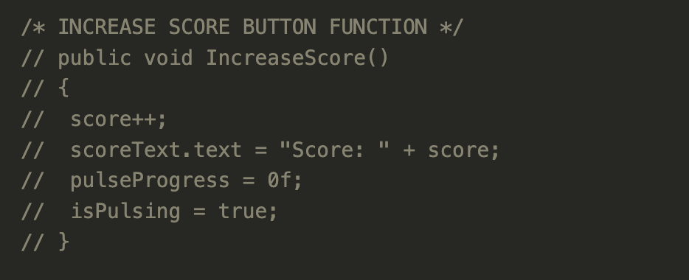
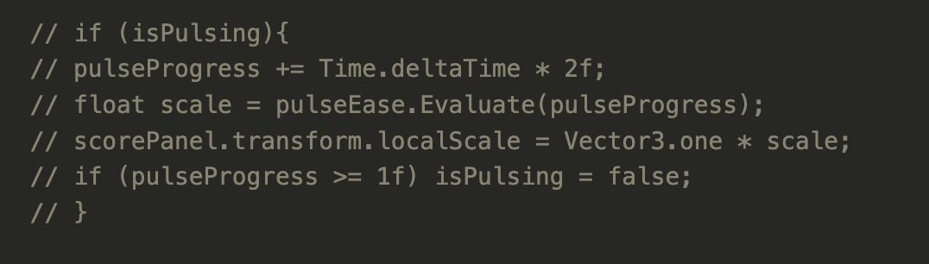
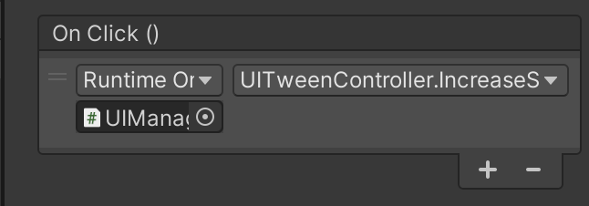
Pulse Animation (public curve)
In the UIManager script, uncomment the public function IncreaseScore() to trigger the start of the Score Board animation when the Increase Button is pressed.
In the Update() Function of the script, uncomment the loop for isPulsing, which controls the timing of the animation after the button is clicked.
Link the Button to the Increase Function:
In the Inspector for the Button_Increase, scroll down to the OnClick() section and select the IncreaseScore() function.
Now, run the game and click the increase button to see the ScoreBoard Animation
Notes:
Makes an object grow and shrink to draw user attention.
Often used for score pop-ups, notifications, or important UI elements.
Starts slow, speeds up, and then slows down before repeating.
What the Curve Represents
The X-axis (horizontal) represents time (0.0 to 1.0, or start to finish of the animation).
The Y-axis (vertical) represents the progress of the animation (0 = starting point, 1 = final position).
The shape of the curve determines the speed and motion style of the animation.
2.
Key Characteristics of This S-Curve
Ease-In (Slow Start)
The curve starts flat near (0,0), meaning the motion begins very slowly.
Dips below x axis to replicate movement anticipation
Before jumping, a character crouches down slightly before pushing off the ground.
This creates a natural acceleration effect, making the movement feel organic rather than robotic.
Example in UI: A panel sliding onto the screen doesn’t instantly move; instead, it begins gently.
Steep Middle Section (Fast Movement)
The steepest part of the curve means the object accelerates quickly.
This is where most of the movement happens in a short amount of time.
This fast transition prevents animations from feeling sluggish or unresponsive.
Overshoot Effect
The curve goes above 1.0 before settling back down.
This means the object moves slightly past its target, then corrects itself.
This adds a bounce-back effect or a sense of elasticity.
Example: A button press that shrinks too much before snapping back to its original size.
Ease-Out (Smooth Stop)
The curve flattens out towards the end.
The motion slows down before stopping rather than stopping abruptly.
This makes the animation feel natural and polished rather than mechanical.

Slide 16
Pulse Animation (public curve)
1. In the UIManager Inspector, locate the public animation curve field
Select the S curve and adjust as needed to create the bounce effect.
Play around with the shape of the curve. What do you notice?
Notes:
Makes an object grow and shrink to draw user attention.
Often used for score pop-ups, notifications, or important UI elements.
Starts slow, speeds up, and then slows down before repeating.
What the Curve Represents
The X-axis (horizontal) represents time (0.0 to 1.0, or start to finish of the animation).
The Y-axis (vertical) represents the progress of the animation (0 = starting point, 1 = final position).
The shape of the curve determines the speed and motion style of the animation.
2.
Key Characteristics of This S-Curve
Ease-In (Slow Start)
The curve starts flat near (0,0), meaning the motion begins very slowly.
Dips below x axis to replicate movement anticipation
Before jumping, a character crouches down slightly before pushing off the ground.
This creates a natural acceleration effect, making the movement feel organic rather than robotic.
Example in UI: A panel sliding onto the screen doesn’t instantly move; instead, it begins gently.
Steep Middle Section (Fast Movement)
The steepest part of the curve means the object accelerates quickly.
This is where most of the movement happens in a short amount of time.
This fast transition prevents animations from feeling sluggish or unresponsive.
Overshoot Effect
The curve goes above 1.0 before settling back down.
This means the object moves slightly past its target, then corrects itself.
This adds a bounce-back effect or a sense of elasticity.
Example: A button press that shrinks too much before snapping back to its original size.
Ease-Out (Smooth Stop)
The curve flattens out towards the end.
The motion slows down before stopping rather than stopping abruptly.
This makes the animation feel natural and polished rather than mechanical.

Slide 17
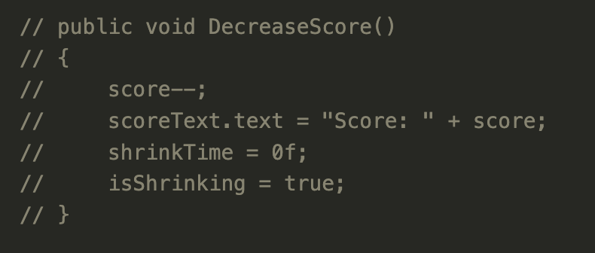
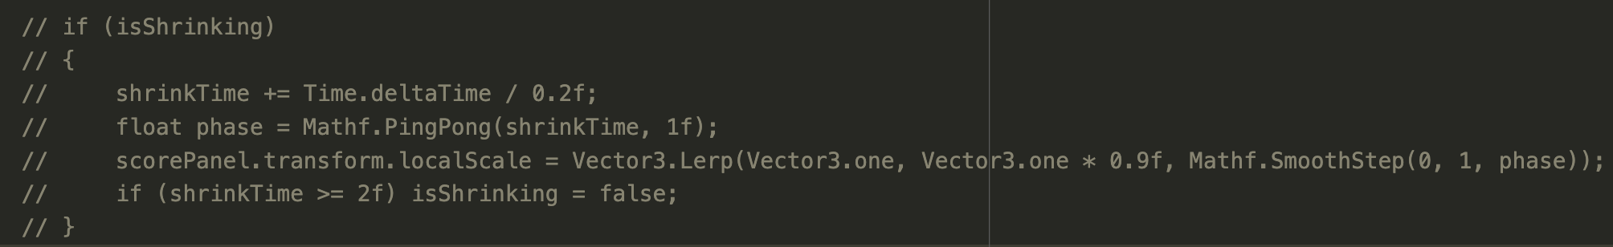
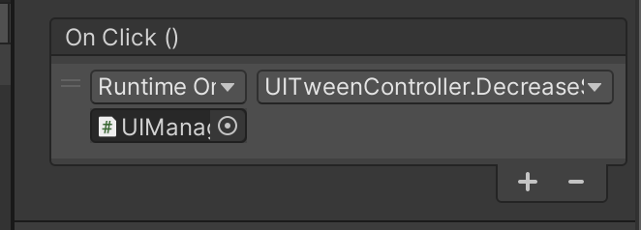
Shrink Animation With Math Functions
In the UIManager script, uncomment the public function DecreaseScore() to trigger the start of the Score Board animation when the Decrease Button is pressed.
In the Update() Function of the script, uncomment the loop for isShrinking, which controls the timing of the animation after the button is clicked.
Link the Button to the Decrease Function:
In the Inspector for the Button_Decrease, scroll down to the OnClick() section and select the DecreaseScore() function.
Now, run the game and click the decrease button to see the ScoreBoard Shrink Animation
Notes:
Decrease Score & Shrink Animation: When the score decreases, the panel briefly shrinks and returns to normal to show points were lost. Mathf.PingPong creates a smooth back-and-forth effect, Vector3.Lerp interpolates between the original and smaller scale, and Mathf.SmoothStep makes the scaling appear gradual and natural.

Slide 18
All together
The Tweening shown in this presentation only shows some of the many tricks that can be done with tweening. I encourage you to play around with what you have now by changing some of the time variables, pixel arguments and animation curves given with ease-in or ease-out.
Now you have a small interface that demonstrates simple UI tweening that can be added to improve the Game Feel of your project!
Notes:
. Why UI Tweening Matters
UI should feel alive and responsive.
Simple scale, fade, and slide effects add polish to the user experience.
Used in all modern apps & games to make interactions feel smooth.
2. Choosing the Right Animation for the Right Context
Fade-in → Great for introducing UI elements smoothly.
Slide-in → Works best for menus, notifications, or panels.
Pulsing → Helps highlight important UI elements.
Shrink on click → Makes buttons feel more tactile.
3. Why We Use LeanTween
Performance optimized for UI animations.
No need for custom Update() logic.
More control over easing, delays, and sequences.

